Slide 1
Tag up with Erin and Jim
May 5, 2021

Slide 2
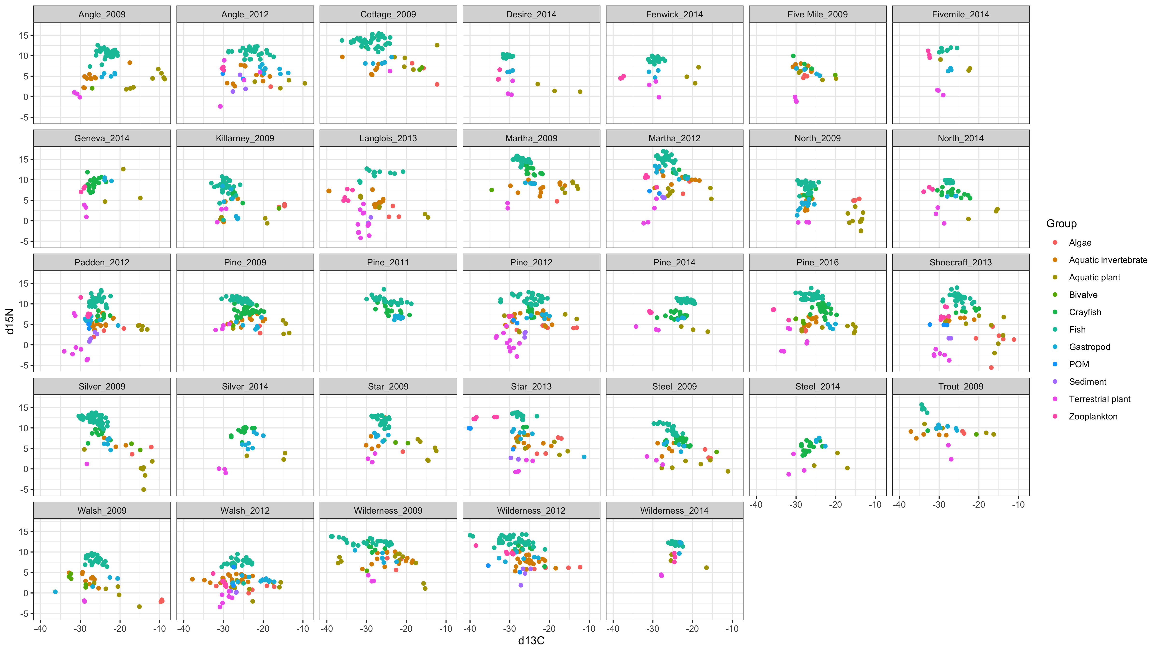

Slide 3
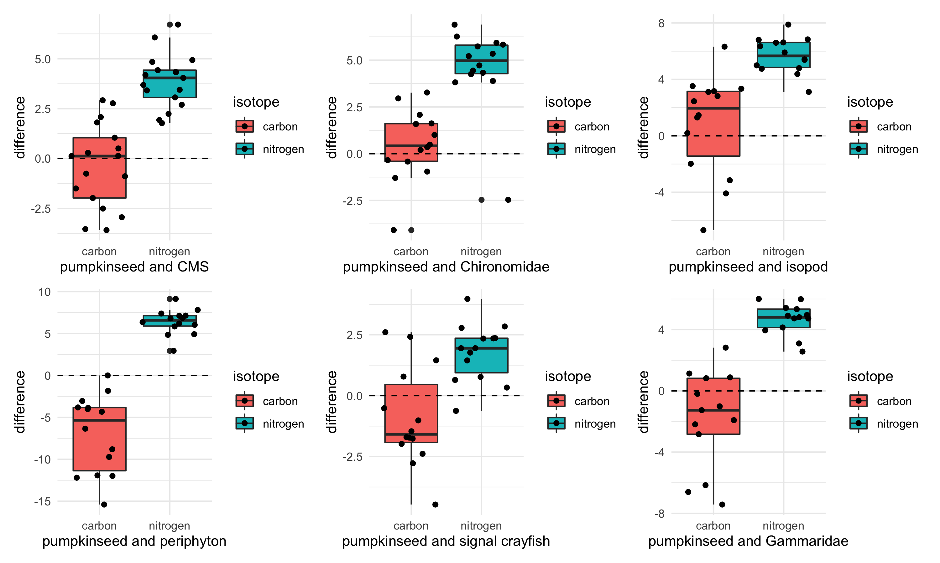
Notes:
Pumpkin seed d13C – comparison organism d13C = values plotted
Each dot is a lake, so we can see how distributed the lakes are, behind the box plot. Quite a bit of variability that could be explored.
If the value is positive, the pumpkinseed is enriched relative to that prey item (pumpkinseed higher d13C value)
If the value is negative, the pumpkinseed is depleted relative to that prey item (pumpkinseed has a lower d13C value)

Slide 4
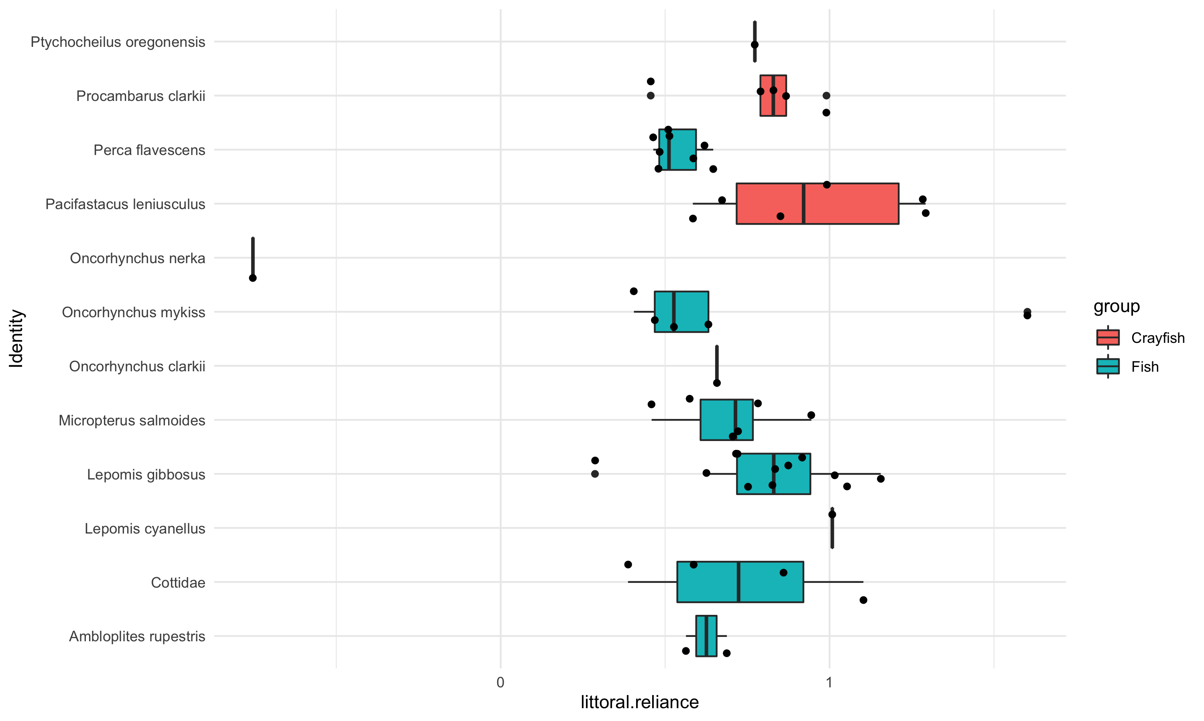
pelagic-littoral reliance
Notes:
This is a basic box plot of the results from lake by lake, littoral vs pelagic stable isotope mixing models, summarized by fish species.
NOTE:: This is 13 of the lake_year sampling events; *only the lakes that had both snails and zooplankton*
Details about the mixing models:
The results were not corrected for over or under-estimated fish or endmembers, hence the <0 and >1 values.
“Snails” includes all snails captured from a lake, so if there was more than one type of snail (or zoop) then I took the mean. Alternatively, I could always choose the most enriched and depleted endmembers if more than one value is available.

Slide 5
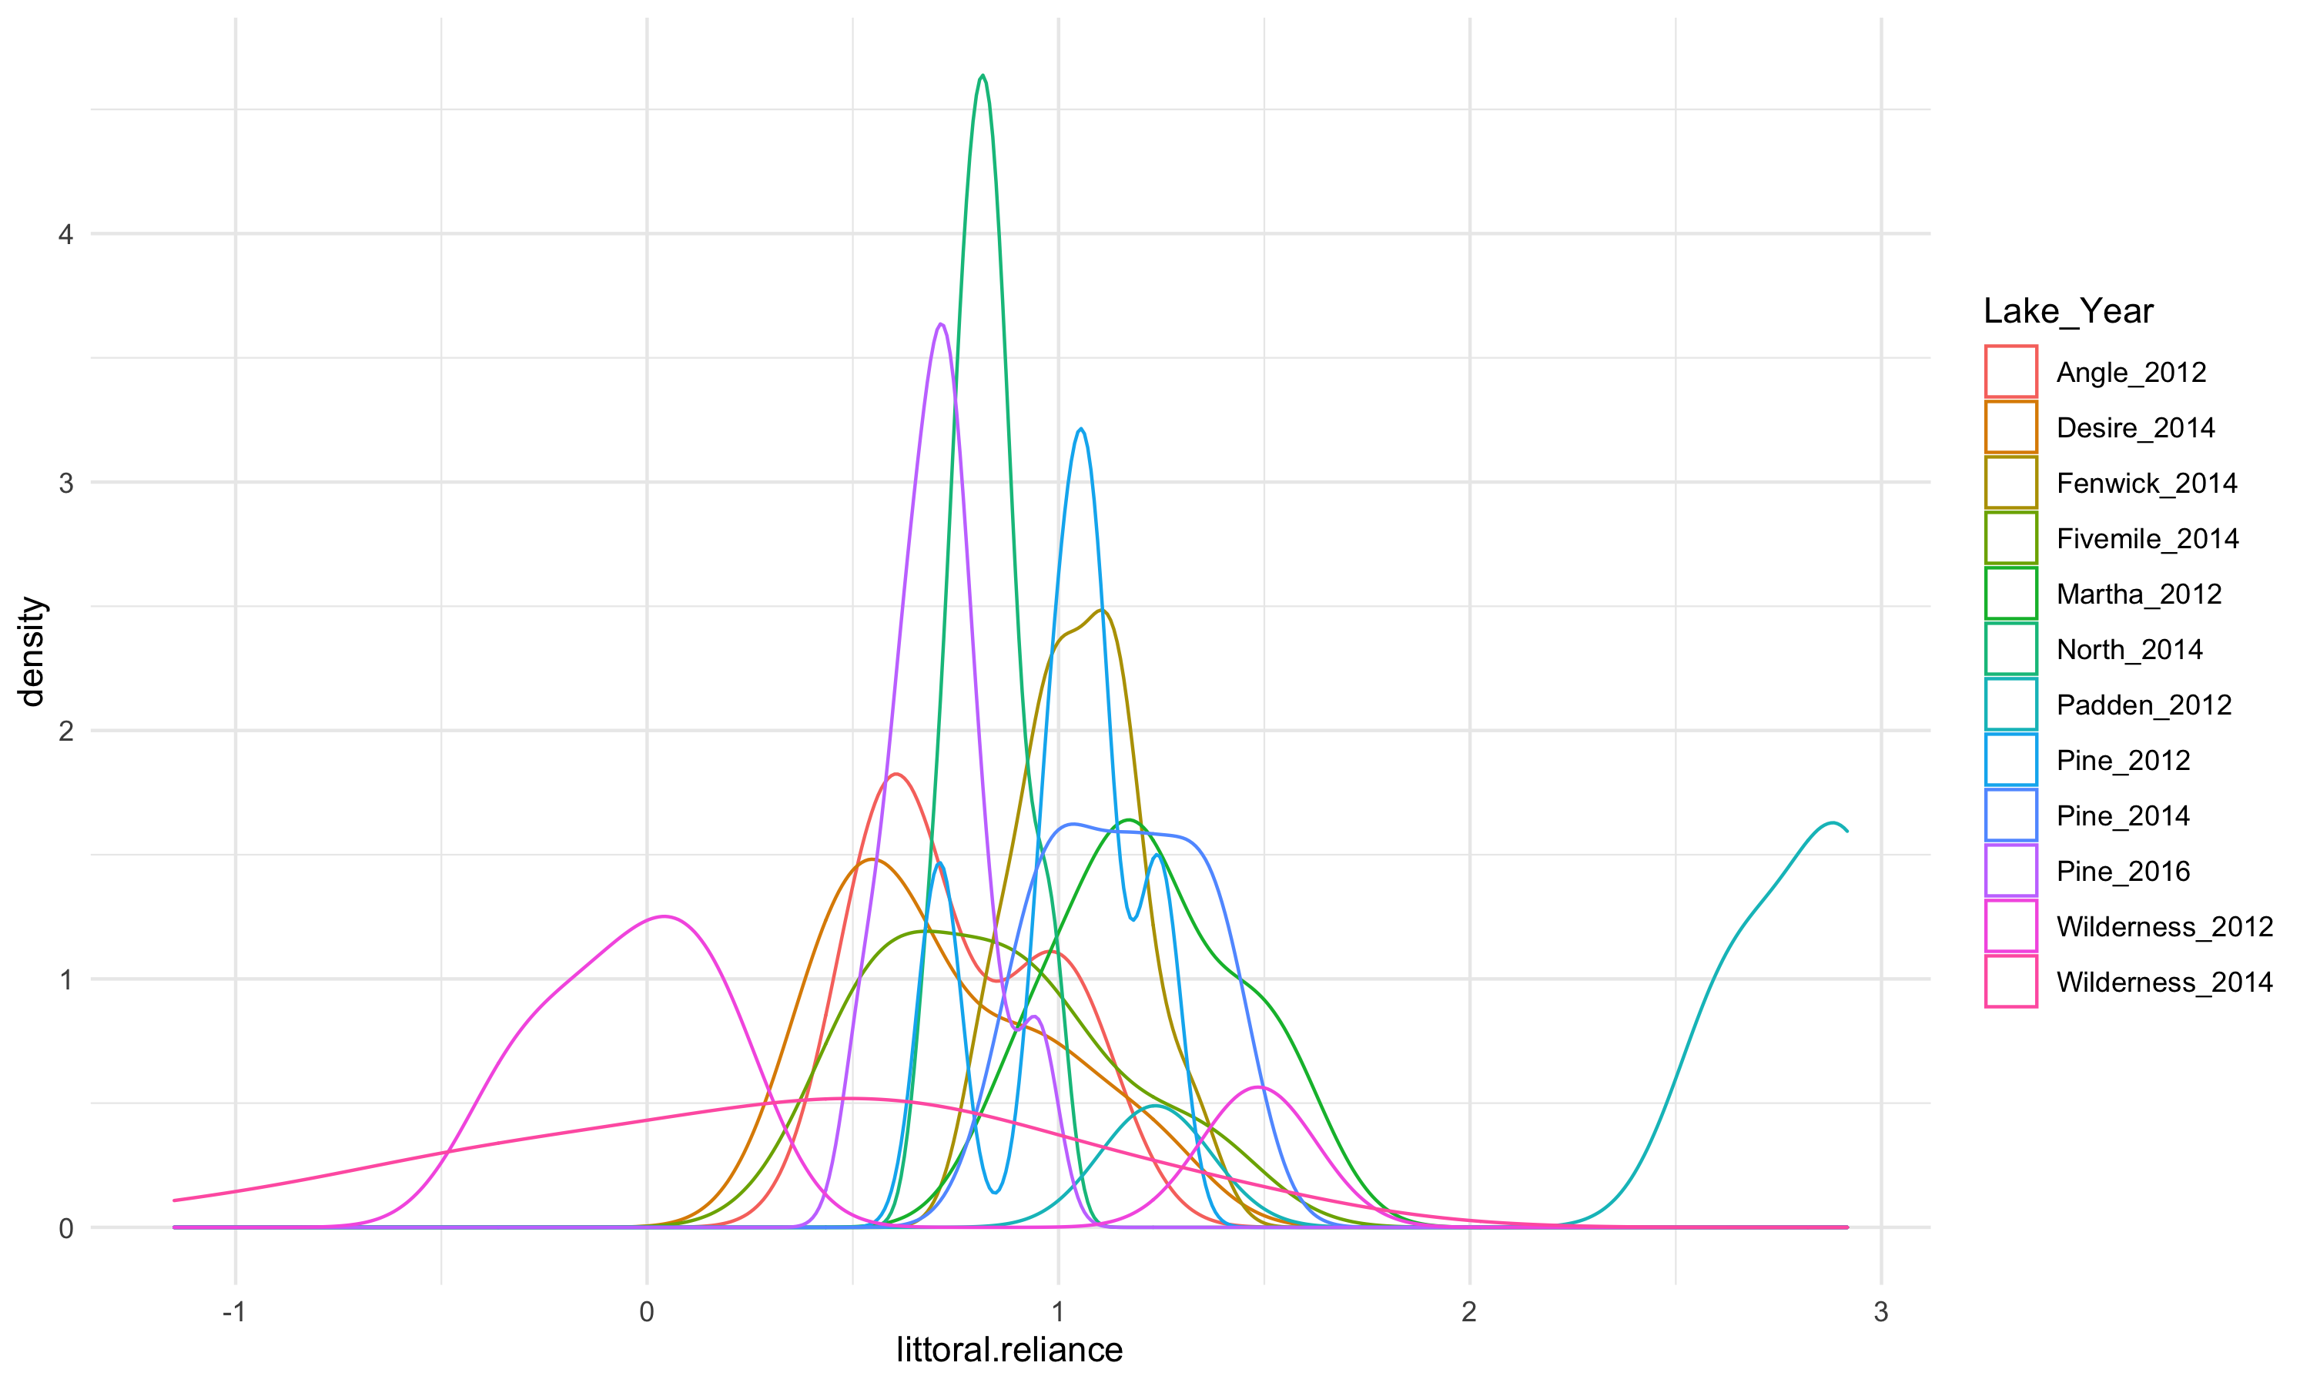
Looking at simple – pelagic vs littoral reliance
Notes:
Density plot to complement the boxplot. Similar info, just an alternative way to look at the littoral-pelagic mixing model results it that lets compare species.

Slide 6
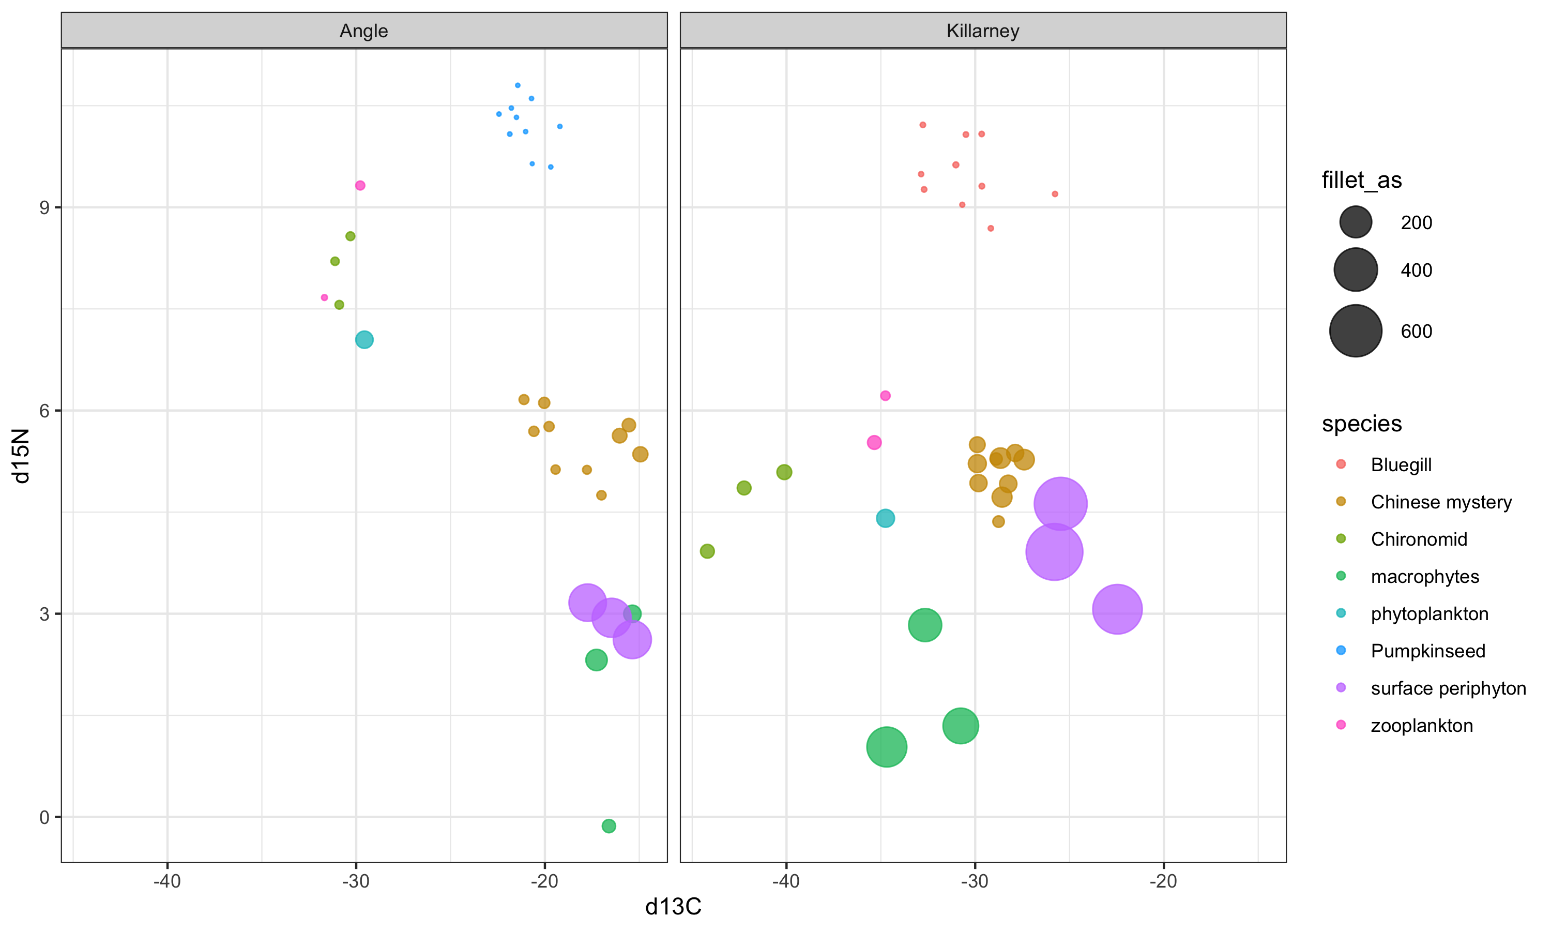
Combined total As µg/g & stable isotopes
Notes:
A quick comparison of all available samples for which we have both C & N isotope data and As data, from the sheet that Erin shared. Circle size reflects the arsenic concentration in ug/g

